Slide 1

Colorectal Cancer & Health Informatics
This data-driven study integrates health informatics principles to address colorectal cancer screening disparities and improve prevention strategies.
By:
Preet Patel
Yachi Patel
Sanika Bishnoi
Rutvik Deshmukh
Ramya Jyotsna Neelakantrao

Slide 2

HINTS 6 Dataset Overview
The dataset for this research is derived from HINTS 6 (Health Information National Trends Survey), conducted by the National Cancer Institute (NCI). It is a nationally representative survey designed to explore how the American public seeks and uses health-related information. The dataset includes variables spanning behavioral, socioeconomic, and health-related domains.
1
Source
HINTS 6, collected between March and November 2022 by the National Cancer Institute.
2
Population
U.S. adults aged 18 and older in non-institutionalized settings.
3
Sample Size
6,252 respondents.

Slide 3
Research Problem Definition
Problem Statement
Research Question
Significance
Colorectal cancer is a leading cause of cancer deaths worldwide. A lack of awareness about screening tests and unhealthy lifestyle factors like insufficient exercise, poor diet, and smoking contribute to the prevalence of the disease. Despite advances in health informatics, these relationships remain underexplored.
Does patient awareness of colorectal cancer screening tests correlate with lifestyle factors like exercise, diet, and smoking status?
This research leverages health informatics to uncover correlations between awareness and lifestyle factors. Findings will inform targeted awareness campaigns, equitable health policies, and technology-driven interventions to improve screening rates and overall outcomes.

Slide 4
Key Variables
DocTellColorectalTests:
Indicates whether a healthcare provider informed the patient about colorectal cancer screening tests.
Type: Categorical (Yes/No).
WeeklyMinutesModerateExercise:
Total weekly minutes spent on moderate-intensity exercise, reflecting physical activity levels.
Type: Continuous (minutes per week).
SmokeStat:
Smoking status categorized as current, former, or never smoked.
Type: Categorical (Current/Former/Never).
UseECigNow:
Indicates whether the individual currently uses e-cigarettes.
Type: Binary (Yes/No).
IncreaseCancer_NEFruitVeg:
Measures insufficient fruit and vegetable consumption, a known risk factor for colorectal cancer.
Type: Ordinal (Low/Moderate/High).
IncreaseCancer_TMProcMeat:
Tracks the frequency of consuming processed meats, which are linked to increased cancer risk.
Type: Ordinal (Low/Moderate/High).
IncreaseCancer_TMFastFood:
Frequency of fast food consumption, indicative of poor dietary habits.
Type: Ordinal (Low/Moderate/High).

Slide 5
Connection to Course Materials & Literature:
Data Analysis & Visualization (Lecture 2)
The visualizations employed in this study, such as histograms and correlation heatmaps, apply principles of clarity and accessibility, reflecting best practices discussed in class.
Behavioral and Socioeconomic Disparities (Lecture 3)
Focus on behavioral data (e.g., smoking, exercise) and socioeconomic factors ties directly to course concepts on addressing social determinants of health through technology.
Data Privacy & Security (Lecture 7)
The handling of HINTS 6 data reflects the principles of privacy and security in health data management, ensuring ethical and compliant research practices.
Natural Language Processing (Lecture 9)
Future research directions propose using NLP for clinical note analysis, aligning with the lecture focus on transforming unstructured data into actionable health insights.

Slide 6




Analytical Approach
Preprocessing
Data cleaning and standardization to ensure quality and consistency.
Variable Exploration
In-depth examination of exercise, awareness, and smoking trends.
Correlation Analysis
Identification of relationships using Python, Matplotlib, and Seaborn.

Slide 7
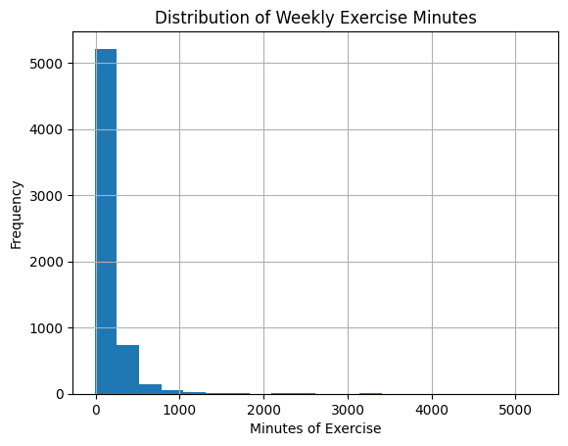
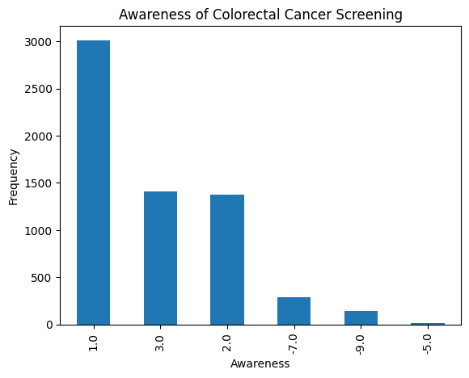
Data Visualizations: Part 1
Distribution of Weekly Exercise Minutes
Awareness of Colorectal Cancer Screening
Histogram showing distribution of weekly exercise minutes.
Bar graph showing the frequency of screening levels.

Slide 8
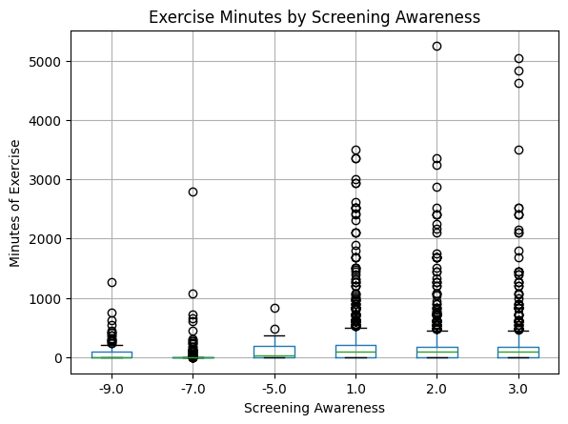
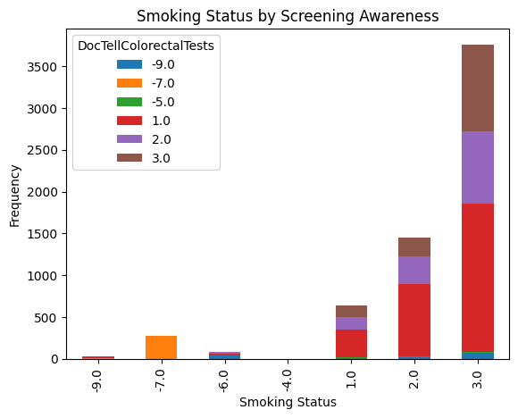
Data Visualizations: Part 2
Exercise Minutes vs Screening Awareness
Smoking Status vs Screening Awareness
Boxplot of exercise minutes across screening awareness levels.
Stacked bar chart of smoking status by screening awareness.

Slide 9
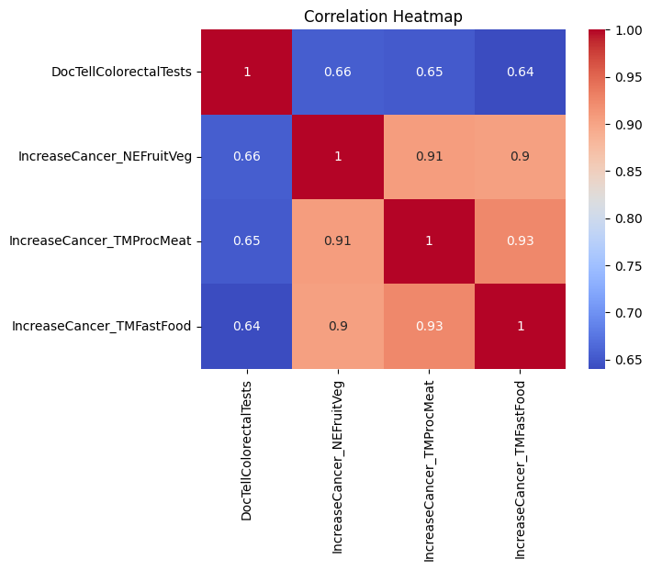
Data Visualizations: Part 3
Correlation Heatmap
Color Gradient: Darker shades of red indicate a strong positive correlation (closer to 1). Blue shades indicate weaker correlations.
Key Correlations: DocTellColorectalTests has moderate positive correlations with dietary and lifestyle factors. IncreaseCancer_NEFruitVeg (insufficient fruit/vegetable intake) strongly correlates with IncreaseCancer_TMProcMeat (processed meat consumption) and IncreaseCancer_TMFastFood (fast food consumption), showing a significant association between these dietary habits.

Slide 10

Implications of Results & Discussion
1
Addressing Behavioral
Barriers
2
Dietary Influence on
Screening Awareness
3
Leveraging Health
Informatics:
Results highlight significant lifestyle factors (e.g., smoking, lack of exercise) associated with low screening awareness. Personalized health interventions, such as wearable fitness trackers or smoking cessation programs, can effectively address these barriers.
Unhealthy dietary habits like high processed meat and fast food consumption correlate with reduced awareness. Campaigns promoting healthy eating can be integrated into screening awareness programs.
Tools like patient portals can deliver tailored educational content, reminders, and resources to encourage screening uptake, particularly in underserved populations.

Slide 11




Future Directions
Limitations
Future Research
Conclusion
Dataset scope and potential unmeasured confounders require further investigation.
NLP for clinical notes analysis and longitudinal studies to validate interventions.
Health informatics demonstrates transformative potential for colorectal cancer prevention.

Slide 12


Thank You
Team Contribution
Questions?
Each member contributed equally to data analysis, visualization, and presentation.
We appreciate your time and welcome any inquiries about our research.

